Slide 1

Digital Money Management System
Present by
01. Sami Ansari
02. Monira Islam
01. Md Jakaria Nur

Slide 2
Problem Statement
Managing finances efficiently is a challenge for individuals and administrators due to:
Difficulty in tracking monthly and yearly expenses across multiple categories.
Limited tools for managing account information securely and conveniently.
Lack of transparency in financial transactions and history.

Slide 3
Solution Proposal System
The Digital Money Management System (DMMS) provides a comprehensive solution to these challenges by offering:
Financial Tracking: Monthly and yearly reports with categorized insights for Food, Housing, Health, Children, and Others.
Account Management: Secure deposits, withdrawals, and account updates with admin-approved deletion requests.
User-Friendly Operations: Simplified transaction history and robust data handling for all users.
Administrative Tools: A centralized dashboard for monitoring accounts, managing requests, and generating reports.

Slide 4
WHAT IS OUR VISION?
This system aims to save the most valuable time for the user and reduce hassle by simplifying the features so that users get friendly service from the host. We are using the V model for this project

Slide 5
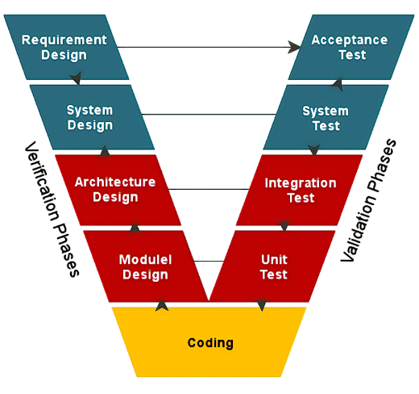

Slide 6


CORE FEATURES
Financial Tracking
User Management
Account Operations
Monitoring & Reporting
Account Management
Security Protocols:

Slide 7
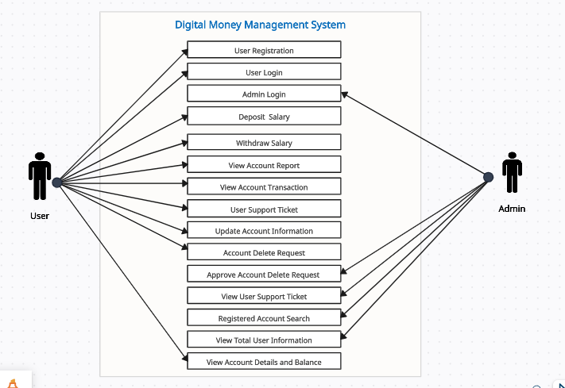

Slide 8
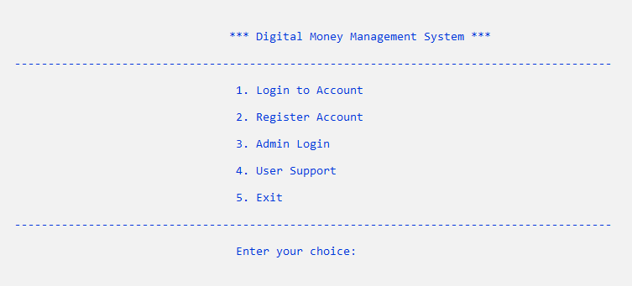
Home Page

Slide 9
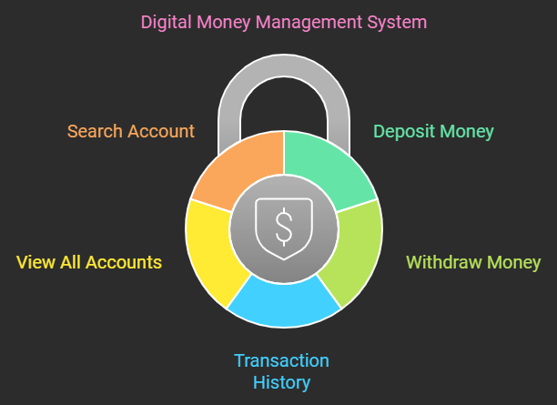
1: Deposit Money 2: Withdraw Money 3: Transaction History 4: View All Accounts 5: Search Account

Slide 10
User Functions
1. Financial Tracking:
○ Monthly and yearly reports for users.
○ Track expenses across categories: Food, Housing, Children, Health, and Others.
○ View transaction history for better financial insights.
2. Account Operations:
○ Deposit and withdraw money.
○ Category-based Withdrawals:
■ Users choose a category (e.g., Food, Housing) before confirming a withdrawal.
○ Update personal account details, including:
■ Name.
■ Account number.
■ Password.
3. Account Management:
○ Account Deletion:
■ Users can request account deletion.
■ Deletion is finalized upon admin approval

Slide 11
Administrative Functions
1. User Management:
○ View a complete list of all user accounts.
○ Search for specific user accounts for detailed management.
○ Approve or decline account deletion requests.
2. Monitoring and Reporting:
○ Access and monitor all accounts on a single page.
○ Generate reports on user activities and system performance.
○ Ensure compliance with financial regulations and maintain system health.
3. Security Protocols:
○ Ensure robust encryption for data security.
○ Validate transactions and maintain a secure database for all activities.

Slide 12
Implementation Details
1. Programming Language:
○ System core built using C language for lightweight, efficient operations.
2. Key Modules:
○ User Module:
■ User authentication and account management.
■ Financial transaction and history tracking.
○ Admin Module:
■ Account approval, deletion, and monitoring tools.
○ Report Generation:
■ Tools for generating monthly and yearly financial summaries.

Slide 13
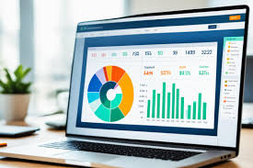
Working Process and Code of Digital Money Management System

Slide 14
Home Page

Slide 15
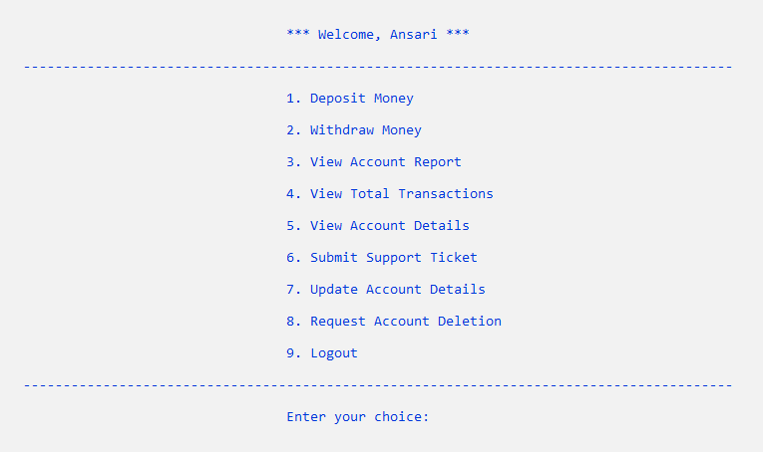
User Dashboard

Slide 16
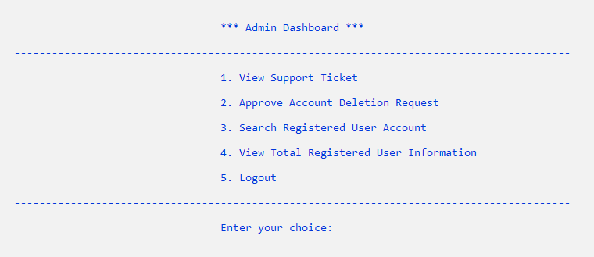
Admin Dashboard

Slide 17
Expected Outcomes
1. Enhanced financial transparency for users.
2. Simplified transaction tracking with categorized withdrawals.
3. Administrative efficiency in handling user accounts and monitoring system activity.
4. Robust security for user data and transactions.

Slide 18
Future Enhancements
1. Integration of a Graphical User Interface (GUI) for a better user experience.
2. Multi-user support within a single application instance.
3. Advanced data export options, including CSV formats.
4. AI-driven financial recommendations based on user spending habits.

Slide 19
Conclusion
The Digital Money Management System bridges the gap between financial technology and user-friendly application design. It offers a seamless experience for tracking finances, managing transactions, and maintaining account security. With potential future upgrades, the system aims to set new standards in digital financial management.

Slide 20

Thank You!

